Slide 1
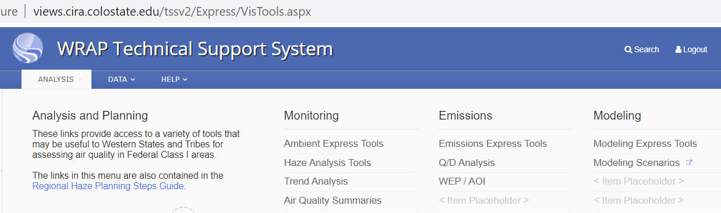
Tasks in green font are now available on the TSS Express Tools.
Monitoring
Emissions Scenarios
HAVO
Model Scenarios
HALE
HAVO
HALE
US
Anthro
Wildfire
WildRxFire
Nat
Intl
IMPROVE Version:
2014v2
2014v2
RepBase2
RepBase2
US Anthro
Rate of Progress
2028OTBa2
2028OTBa2
Dec 2019
2028PAC2
2028OTB Weighted Emissions Potential
2028PAC2
October 2019
2028OTBa2 + Widfire
2002 Hindcast
EPA Hawaii Volcano adjustments - 2021
2028OTBa2 + RxFire
2028OTBa2+ RxFire
2002 Hindcast
2028OTBa2 + Widfire
EPA Data Substitutions April/June 2020
2014 Point Q/d Ranking
Regional Source Apportion
State/Sector Apportion

Slide 2
Emissions Scenarios
US Anthro
CA redo
US-RxF
US-Agf
US-Wf
Biogenic
LtNOx
WbDust
Oceanic
AllotherNAT
US Anthro
Intl-CMV
Intl-Can
Intl-Mex
Intl-BC
US Fire
All other Natural
Intl Anthro
2002 Hindcast
2028OTBa2 + PAC2
2028OTBa2 + RxFire
2014v2
RepBase2
2028OTBa2
2028OTBa2 + Widfire
updated from June 23, 2020 - status as of July 20, 2021

Slide 3
WRAP Source Groups in Regional and State by Sector Source Apportionment
TSS Emissions Source Category: 2014v2, RepBase, 2028 Projections | WRAP Anthropogenic State by Sector Source Apportionment –2028OTBa2 only AmmNO3 and AmmSO4 | Regional Source Apportionment – 2002Hindcast, RepBase2, 2028OTBa2
Electric Generating Units | EGU Point | US Anthropogenic + Secondary Organic Aerosol- Anthropogenic
Industrial Point | Non-EGU Point
Oil&Gas Point | Oil&Gas Area+Point
Oil&Gas Nonpoint
Fugitive Dust | Remaining Anthro
Agriculture
Residential Wood Combustion
Remaining Nonpoint
Commercial Marine | Total Mobile
On Road Mobile
Nonroad Mobile
Rail
Agricultural Fire | Remaining Anthro | US Ag Fires
Prescribed Wildland Fire | Prescribed Wildland Fire | US Prescribed Wildland Fire
Wildfire | Relies on 2028OTBa2 Regional Source Apportionment | US Wildfire
Non US fire |  | Canada + Mexico fire
Biogenic |  | Natural + Secondary Organic Aerosol - Biogenic
Windblown Dust
Lightening NOx
Oceanic
Canadian Anthro |  | Canadian Anthro
Mexican Anthro |  | Mexican Anthro
Commercial Marine- International |  | CMV-Int
US Anthro defined by GEOS-Chem outside 36-km CAMx grid |  | BC-US
International Anthro defined by GEOS-Chem |  | BC-Int
International Natural defined by GEOS-Chem |  | BC-Natural

Slide 4
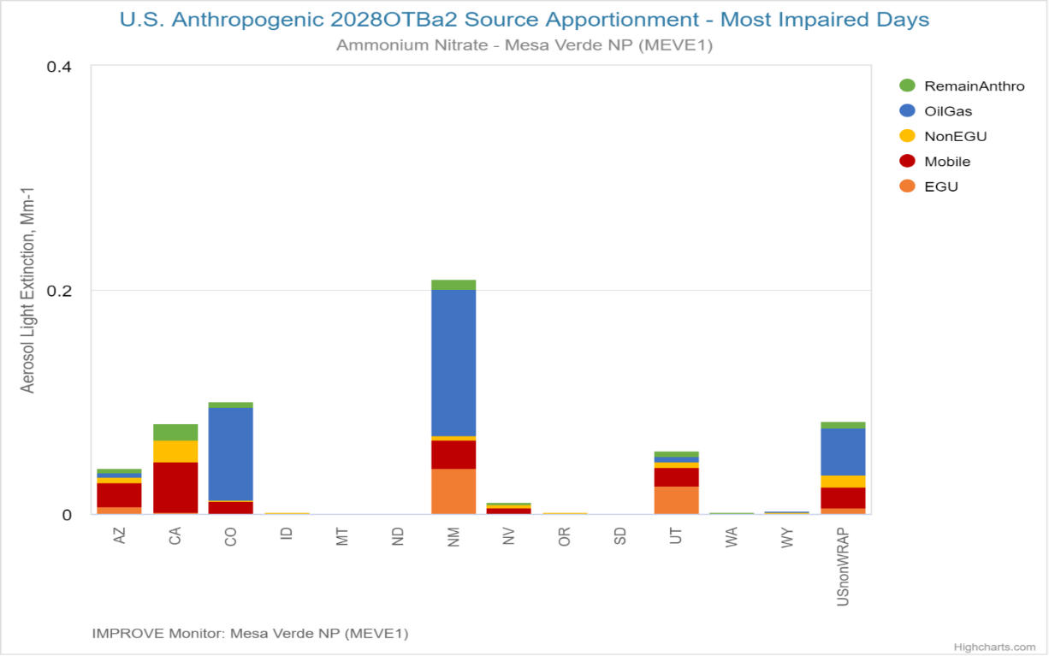
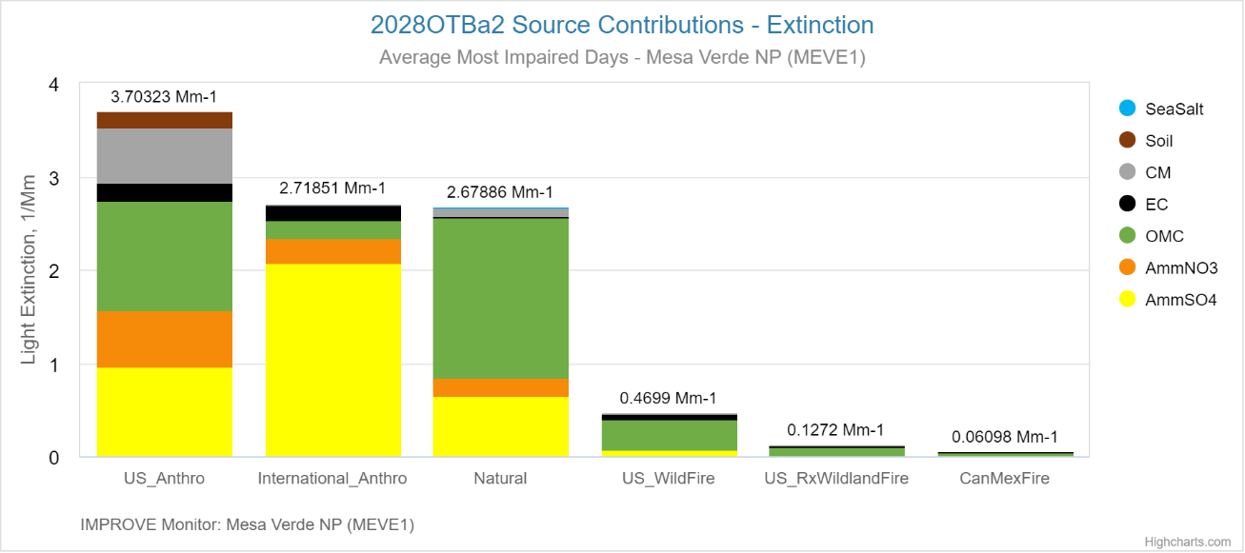
Regional and State by Sector Source Apportionment

Slide 5
Wildfire and Wildland Prescribed Fire Sensitivities:
Emissions Changes from constant RepBase2/2028OTBa2 fire activity, by State, in Acres and Tons of PM2.5

